Slide 1



Uncovering Patterns
in Student Work
Machine learning to understand human learning
Dissertation Defense:
Chris Piech
Advisors: Leonidas Guibas
and Mehran Sahami

Slide 2


Four Prototypical Trajectories
Imagine your brain

Slide 3
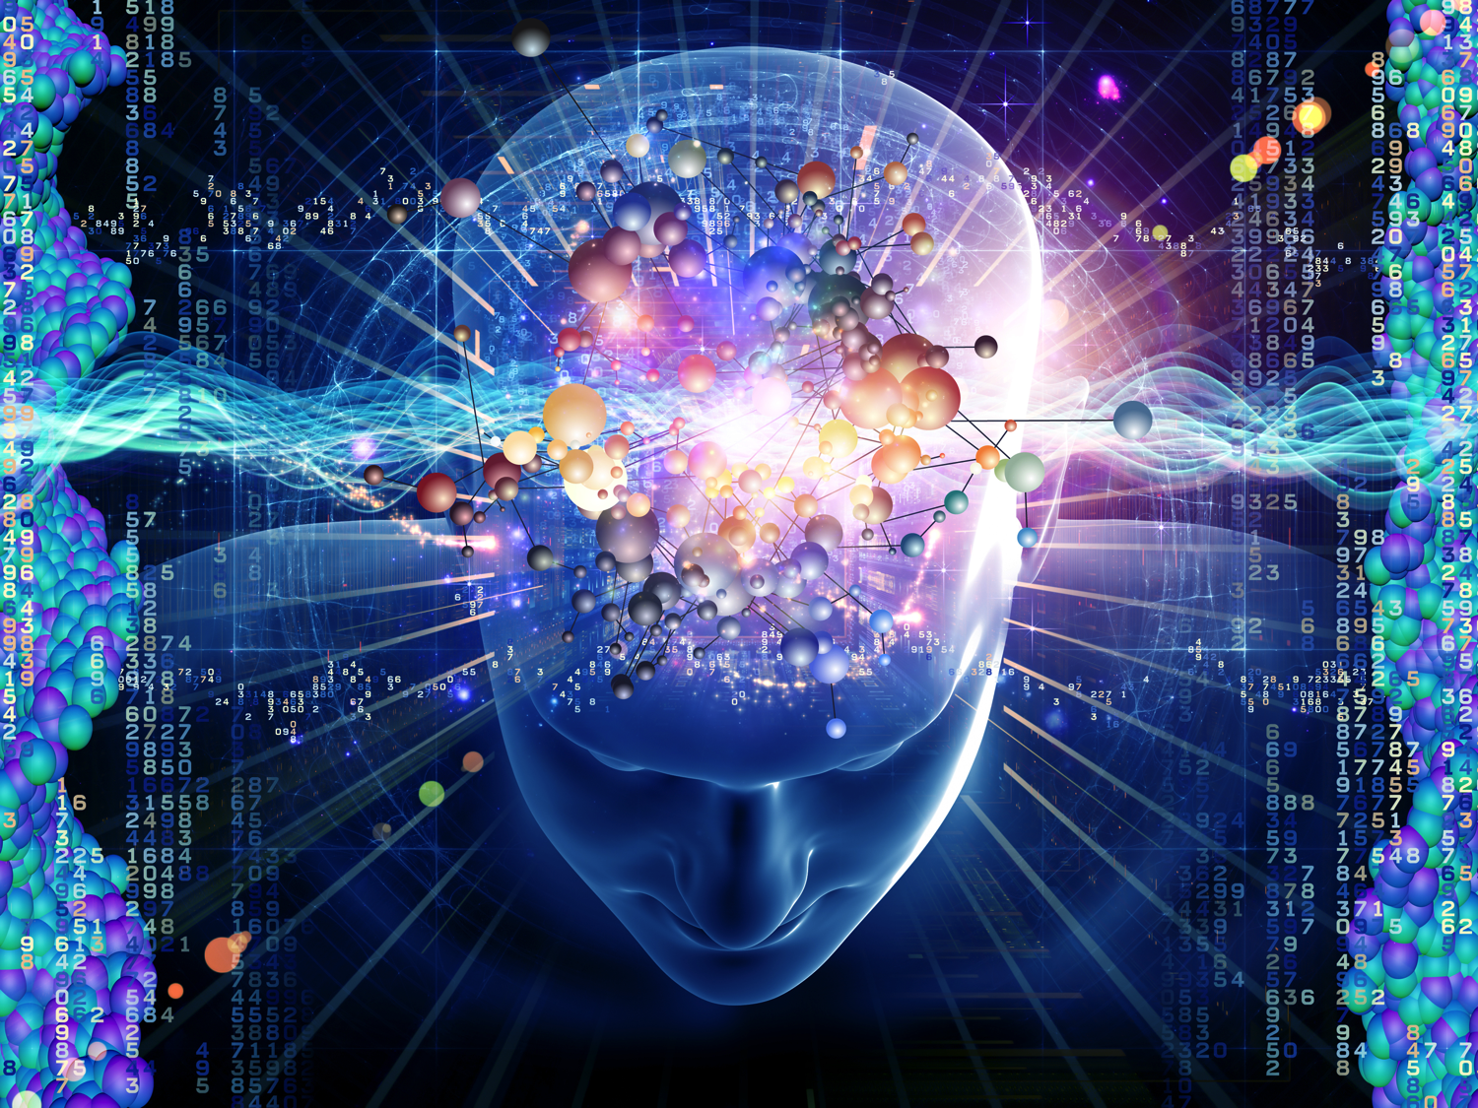

Slide 4
Four Prototypical Trajectories
How would you model your brain learning?

Slide 5
Grand Challenge in Education
Clear
Societal Need
Grand Challenge
in Education
Increase
education
productivity
Autonomously support teachers. Can we
understand individual learning and provide
quality feedback for students as they work
on assignments?
MOOC
assignments
Neural
networks
New
Datasets of
Learning
New Machine
Learning
Education debt > Consumer debt

Slide 6

Shortage of Quality Education
90% of children enroll in primary education [1]
40% in secondary education [1]
20% in tertiary education [1]
Dramatic quality differences
Education debt > Consumer debt
[1] World development indicators 2015. World Bank Publications, 2015.

Slide 7
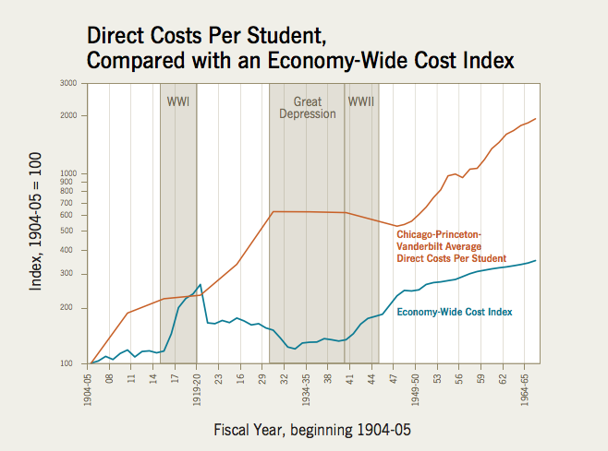
Cost Disease of Education
Give quality feedback to complex assignments.
Education debt > Consumer debt
William G Bowen. The cost disease in higher education: Is technology the answer. 2012.

Slide 8
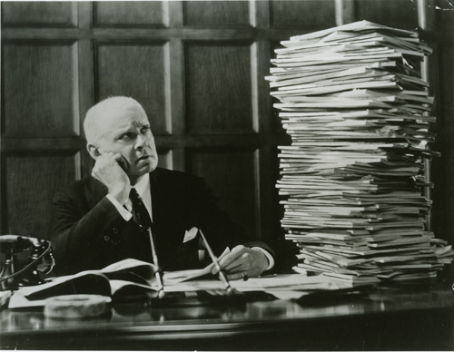

Feedback is Labor Intensive
Online classes hasn’t solved the feedback problem.
Notes:
Andrew NG can’t grade all 1 million assignments, but he can afford to grade 500. The crux of the problem is to decide if two programs deserve the same feedback. If they do, and we have given feedback to one program, we can simply copy and paste that feedback. This can be posed as a supervised learning problem.

Slide 9

[Kid President]

Slide 10
We could give feedback to programming assignments at scale
[Kid President]

Slide 11

Hard Problem
Students forget
Short term and long term memory
Transfer knowledge (complex)
Zone of proximal development
Individual differences

Slide 12






Unprecedented Data
Over 50 million learners

Slide 13
US K-12 Students
= 500,000 learners

Slide 14
Code.org Students
= 500,000 learners

Slide 15

Feedback at Scale is a Grand Challenge
[paintinghere.com]
Notes:
I would like to start by taking a moment to appreciate Beautiful assignments. And when I say Beautiful Im thinking you know the capital B.
really engaging with.
Make something that they are proud of,
go way above and beyond.
show their mom,
maybe that exposes them to the best part of working in your discipline and hopefully something that changes their identity
The sort of assignment that you give to students and you tell them “your going to love this.”… and their like “well actually, Chris, I was planning on going on a hike with my friends….”
Beautiful with a captal B. The good stuff in school

Slide 16
Feedback at Scale is a Grand Challenge
Spectrum of Assignmnt Complexity

Slide 17
Feedback at Scale is a Grand Challenge
Design a Product
Programs
Write a Poem
Multiple Choice
Math Proofs
Short Answer

Slide 18
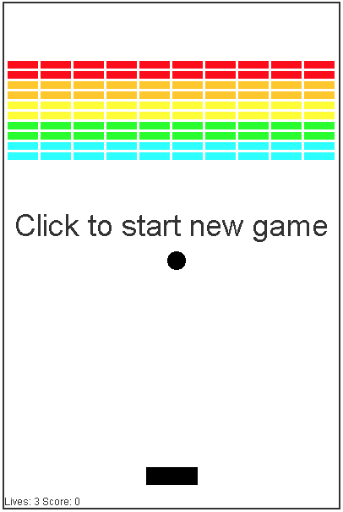
Feedback at Scale is a Grand Challenge
Design a Product
Programs
Write a Poem
Multiple Choice
Math Proofs
Short Answer

Slide 19
Especially Inefficient for CS
Projected # jobs in computing
Projected # CS Students

Slide 20


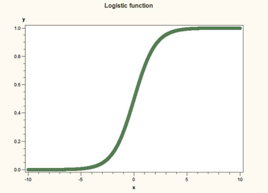
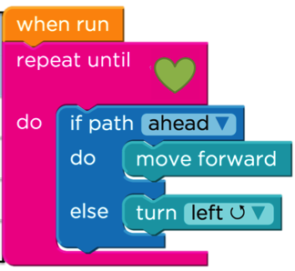
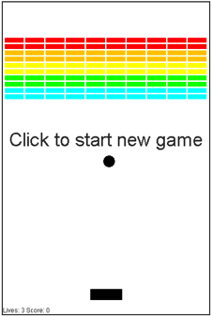
Datasets (1/2)
Machine Learning
Machine Learning
Hour of Code
CS106A
20K Students
20 Assignments
Submissions
1.2M Students
20 Assignments
Full trajectories
3K Students
15 Assignments
Full trajectories

Slide 21


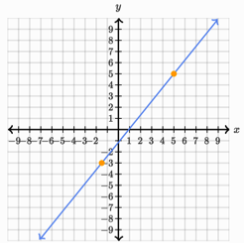
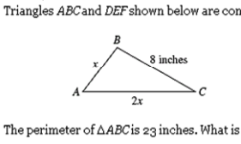
Datasets (2/2)
Eighth Grade
Common Core
Human Computer
Interaction
120K Students
70 Question Types
Full trajectories
16K Students
124 Question Types
Full Trajectories

Slide 22






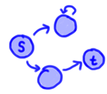
Zipf’s Law
Assignment A
Assignment B
Assignment C
Assignment D
Percent of Submissions
s = 1.42
s = 1.82
s = 2.14
s = 2.67
Submission Rank Index
int func(int a,
return a +
}
Correct /
Incorrect
Maze
Programming
Control
Flow
General
Programming

Slide 23
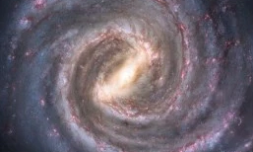

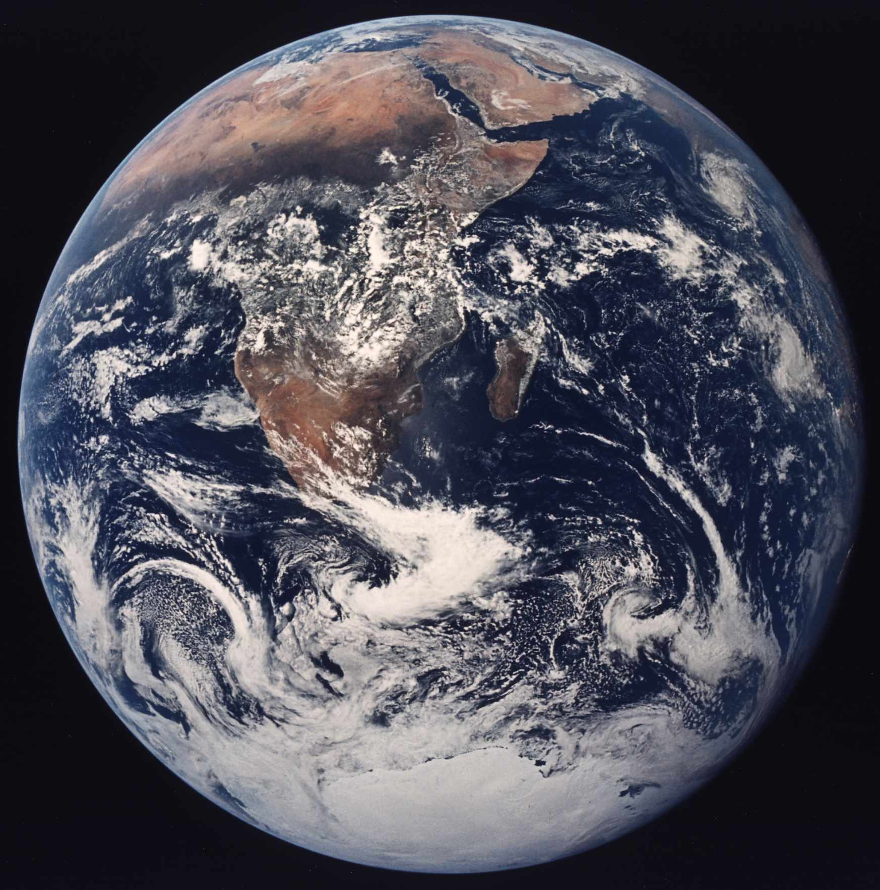
Order of Magnitude of Understanding
Understanding Curriculum Navigation
Understanding Assignment
Navigation
Understanding Solution
Space

Slide 24
Progress
Understanding Curriculum Navigation
Understanding Assignment
Navigation
Understanding Solution
Space
Peer
Grading
Correct/
Incorrect
Maze
Programs
Control Flow Programs
General Programs

Slide 25







Progress
Understanding Curriculum Navigation
1
Understanding Assignment
Navigation
2
Understanding Solution
Space
3
3
3
Peer
Grading
Correct/
Incorrect
Maze
Programs
Control Flow Programs
General Programs

Slide 26
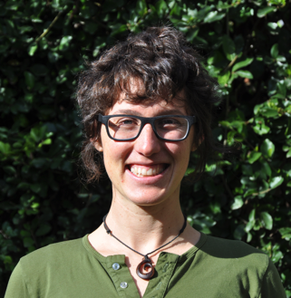
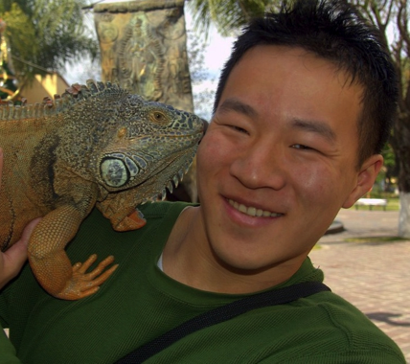




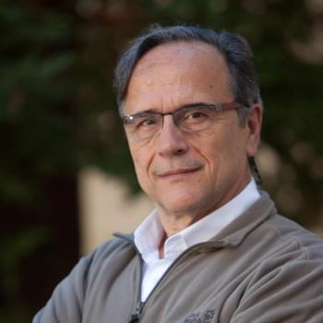

The People
Jon Huang
Jascha Sohl-Dickstein
Jon Bassen
Mike
Andy Nguyen
Mehran Sahami
Leo Guibas

Slide 27

Today’s Goals
Introduce the zeitgeist of data driven education
Show the progress that I have made

Slide 28

Thesis Route
Thesis
Solution
Space
Assignment
Paths
Curricula
Challenge

Slide 29

Thesis Route
Thesis
Solution
Space
Assignment
Paths
Curricula
Challenge

Slide 30
Thesis Route
Thesis
Solution
Space
Assignment
Paths
Curricula
Challenge

Slide 31
Four Prototypical Trajectories
How do Students Learn Across Curricula?

Slide 32
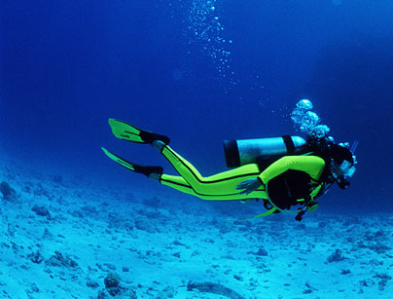
Deep Knowledge Tracing

Slide 33

Story of Riley
1
10
20
30
40
50
Exercise index
Exercise Type:
Answer:
Solving for x-intercept
Correct
Solving for y-intercept
Incorrect
Graphing linear equations
Square roots
Slope of a line

Slide 34
Story of Riley
1
10
20
30
40
50
Exercise index
Exercise Type:
Answer:
Solving for x-intercept
Correct
Solving for y-intercept
Incorrect
Graphing linear equations
Square roots
Slope of a line

Slide 35
Story of Riley
1
10
20
30
40
50
Exercise index
Exercise Type:
Answer:
Solving for x-intercept
Correct
Solving for y-intercept
Incorrect
Graphing linear equations
Square roots
Slope of a line

Slide 36
Story of Riley
1
10
20
30
40
50
Exercise index
Exercise Type:
Answer:
Solving for x-intercept
Correct
Solving for y-intercept
Incorrect
Graphing linear equations
Square roots
Slope of a line

Slide 37
Story of Riley
1
10
20
30
40
50
Exercise index
Exercise Type:
Answer:
Solving for x-intercept
Correct
Solving for y-intercept
Incorrect
Graphing linear equations
Square roots
Slope of a line

Slide 38
Story of Riley
1
10
20
30
40
50
Exercise index
Exercise Type:
Answer:
Solving for x-intercept
Correct
Solving for y-intercept
Incorrect
Graphing linear equations
Square roots
Slope of a line

Slide 39
Story of Riley
1
10
20
30
40
50
Exercise index
What should Riley do next?
Exercise Type:
Answer:
Solving for x-intercept
Correct
Solving for y-intercept
Incorrect
Graphing linear equations
Square roots
Slope of a line

Slide 40
Story of Riley
1
10
20
30
40
50
Exercise index
51
60
70
80
Exercise index
Exercise Type:
Answer:
Solving for x-intercept
Correct
Solving for y-intercept
Incorrect
Graphing linear equations
Square roots
Slope of a line

Slide 41
Four Prototypical Trajectories
There are millions of Rileys
#iamriley

Slide 42



Knowledge Tracing
Given n historical answers:
…
Answer is a tuple:
Predict the next one
Question id
Correct or not

Slide 43
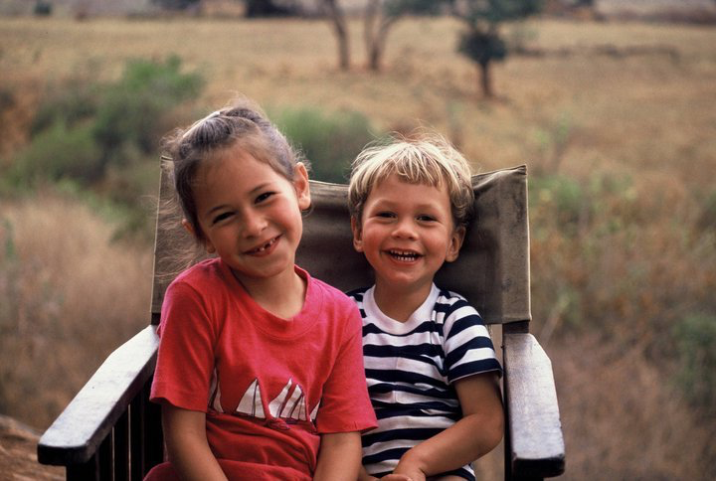
Old Problem
First posed in 1993
Education debt > Consumer debt

Slide 44
Limits of the State of the Art
Needs fine grained concept labels
No way to model correspondences between concepts
Can only handle correct/incorrect questions
Addressed by Deep Knowledge Tracing
Discrete representation is unrealistic
Can’t incorporate long term interactions

Slide 45
Four Prototypical Trajectories
Lets look to another domain

Slide 46
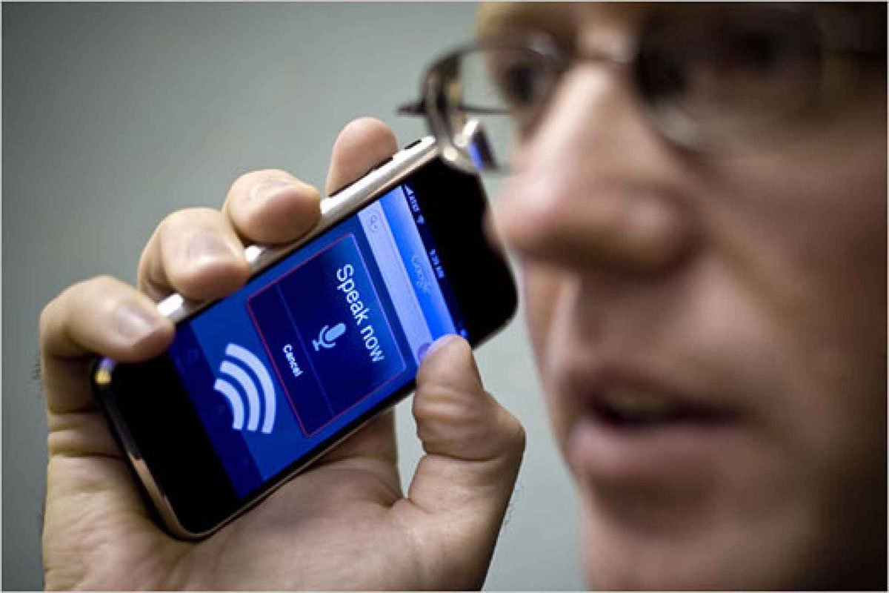
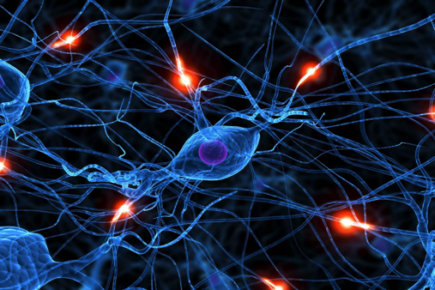
Speech Recognition

Slide 47
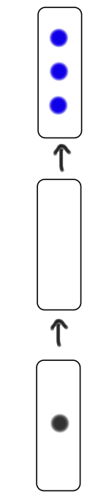
Deep Knowledge Tracing
y
h
x

Slide 48
Deep Knowledge Tracing
y
Prediction of future student interaction
A vector which represents underlying “neurons”
h
x
Vector encoding of student interaction

Slide 49

Deep Knowledge Tracing
h₀

Slide 50
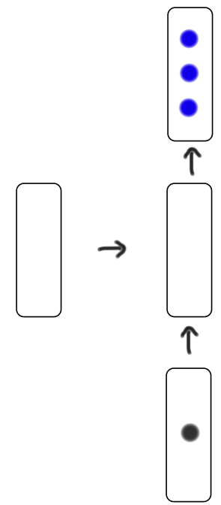
Deep Knowledge Tracing
y₁
h₀
h₁
x₁

Slide 51
Deep Knowledge Tracing
y₁
h₀
h₁
x₁

Slide 52
Deep Knowledge Tracing
y₁
h₀
h₁
x₁

Slide 53
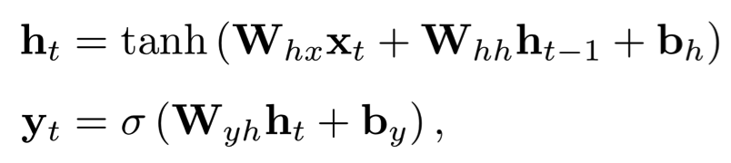
Deep Knowledge Tracing
y₁
h₀
h₁
x₁

Slide 54
Deep Knowledge Tracing
y₁
h₀
h₁
x₁

Slide 55
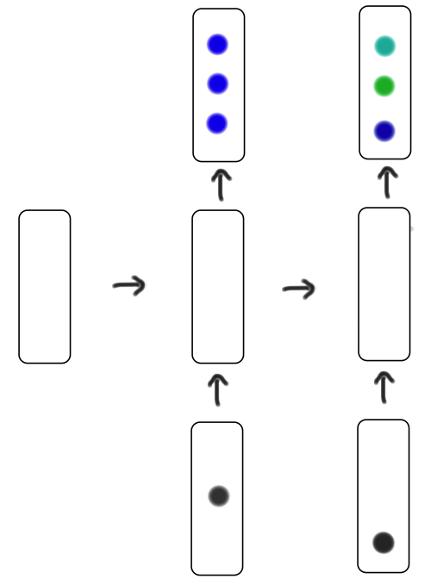
Deep Knowledge Tracing
y₁
y₂
h₀
h₁
h₂
x₁
x₂

Slide 56
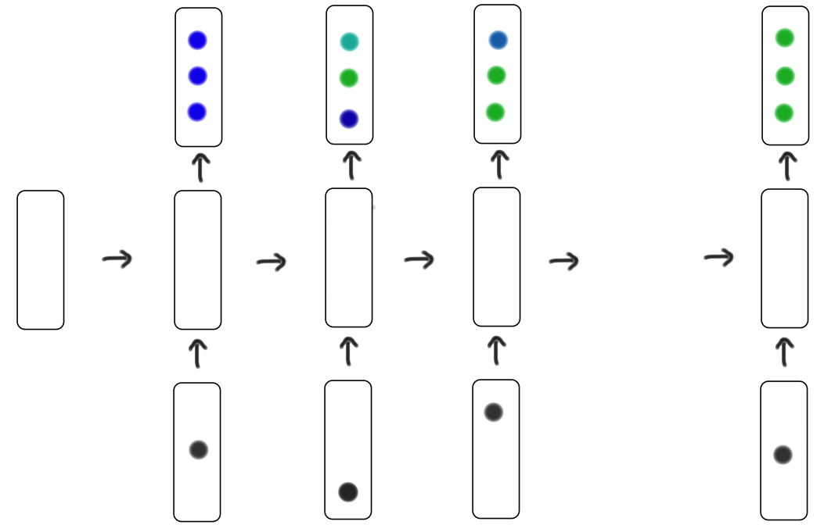
Deep Knowledge Tracing
y₁
y₂
y₃
y_{T}
…
h₀
h₁
h₂
h₃
h_{T}
x₁
x₂
x₃
x_{T}

Slide 57

How to represent action?
Answer is a tuple:
One-hot
encoding of (question, answer) tuple
Question id
Correct or not
N = 2 x |questions|

Slide 58
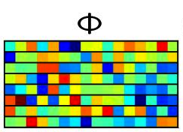
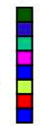
Compressed Sensing
M x 1
One-hot
encoding
New Input
Vector
=
N x 1
Random Matrix
M x N
M can be around log(N) with good results

Slide 59
Four Prototypical Trajectories
Results?

Slide 60
Four Prototypical Trajectories
[suspense]

Slide 61
Four Prototypical Trajectories
Synthetic Data

Slide 62
Synthetic Data
Question 1
Question 50
Student 1
…
Student 2
…
Student 2000

Slide 63
Item Response Theory Data
Oracle

Slide 64
Item Response Theory Data
Oracle
State of the Art

Slide 65
Item Response Theory Data
Oracle
Our Methods
State of the Art

Slide 66
Item Response Theory Data
Oracle
Our Methods
Works without expert concept labels!
State of the Art

Slide 67
Learns Concepts
Hidden concept 1
Hidden concept 2
Hidden concept 3
Hidden concept 4
Hidden concept 5

Slide 68
Learns Concepts
Hidden concept 1
Hidden concept 2
Hidden concept 3
Hidden concept 4
Hidden concept 5

Slide 69
Learns Concepts
Hidden concept 1
Hidden concept 2
Hidden concept 3
Notice the length in time!
Hidden concept 4
Hidden concept 5

Slide 70



Datasets
47 thousand students
16 thousand students
4 thousand students
69 question tags
124 question tags
50 question tags

Slide 71
Four Prototypical Trajectories
Real Data

Slide 72

Prediction Results
RNN vs LSTM didn’t matter too much
Huge improvement in ability to predict for real students

Slide 73
Learns Concept Relationships
Scatter plots
Pythagorean
theorem
Lines
Angles
Functions
Exponents
Systems of
Equations
Line graphs
Fractions

Slide 74
Learns Concept Relationships

Slide 75
Learns Concept Relationships
Finding the x-intercept

Slide 76
Learns Concept Relationships
Finding the y-intercept

Slide 77
Learns Concept Relationships
Slope of a line

Slide 78
Learns Concept Relationships
Graphing
Linear Equations

Slide 79
Learns Concept Relationships
Graphing
Systems of Equations

Slide 80
Just Transitions?
No!

Slide 81
Just Conditional Probabilities?
No!

Slide 82
Learns Concept Relationships
Scatter plots
Pythagorean
theorem
Lines
Angles
Functions
Model can demonstrate convincing binary relationships
Exponents
Systems of
Equations
Line graphs
Fractions

Slide 83
Four Prototypical Trajectories
Optimal Curriculum

Slide 84
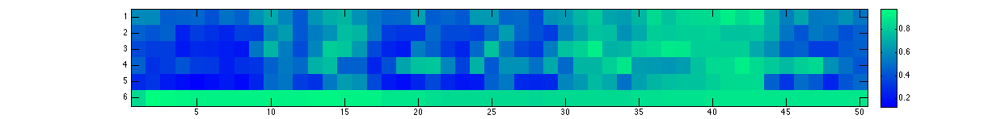
Predicting Next Item
Exercise attempted: correct, incorrect
1.0
Predicted Probability
0.5
10
20
30
40
50
0.0
Exercise index
Line graph intuition
Slope of a line
Solving for x-intercept
Solving for y-intercept
Graphing linear equations
Square roots

Slide 85
Predicting Next Item
Exercise attempted: correct, incorrect
1.0
Predicted Probability
0.5
10
20
30
40
50
0.0
Exercise index
Line graph intuition
Slope of a line
Solving for x-intercept
Solving for y-intercept
Graphing linear equations
Square roots

Slide 86
Predicting Next Item
Exercise attempted: correct, incorrect
1.0
Predicted Probability
0.5
10
20
30
40
50
0.0
Exercise index
Line graph intuition
Slope of a line
Solving for x-intercept
Solving for y-intercept
Graphing linear equations
Square roots

Slide 87
Predicting Next Item
Exercise attempted: correct, incorrect
1.0
Predicted Probability
0.5
10
20
30
40
50
0.0
Exercise index
Line graph intuition
Slope of a line
Solving for x-intercept
Solving for y-intercept
Graphing linear equations
Square roots

Slide 88
Predicting Next Item
Exercise attempted: correct, incorrect
1.0
Predicted Probability
0.5
10
20
30
40
50
0.0
Exercise index
Line graph intuition
Slope of a line
Solving for x-intercept
Solving for y-intercept
Graphing linear equations
Square roots

Slide 89
Predicting Next Item
Exercise attempted: correct, incorrect
1.0
Predicted Probability
0.5
10
20
30
40
50
0.0
Exercise index
Line graph intuition
Slope of a line
Solving for x-intercept
Solving for y-intercept
Graphing linear equations
Square roots

Slide 90
Predicting Next Item
Exercise attempted: correct, incorrect
1.0
Predicted Probability
0.5
10
20
30
40
50
0.0
Exercise index
Line graph intuition
Slope of a line
Solving for x-intercept
Solving for y-intercept
Graphing linear equations
Square roots

Slide 91
Predicting Next Item
Exercise attempted: correct, incorrect
1.0
Predicted Probability
0.5
10
20
30
40
50
E[p]
0.0
Exercise index
Line graph intuition
We can find what is the “deal maker”
Slope of a line
Solving for x-intercept
Solving for y-intercept
Graphing linear equations
Square roots

Slide 92
Optimal Curriculum

Slide 93
Optimal Curriculum
Maximize knowledge after 30 questions

Slide 94
Optimal Curriculum
Maximize knowledge after 30 questions

Slide 95
Optimal Curriculum
Maximize knowledge after 30 questions
Model makes optimal curriculum learning more possible.
MDP-8 is intractable in real time.

Slide 96


Overview
Contributions
Limitations
State of the art (on two classic large datasets).
Trains overnight for
47K students
Does not need “concept” labels.
Will it work on small
datasets?
Can express graph of concept interactions.
High dimensional knowledge
representation.
Enables optimal teaching
curricula.
Potential to trace knowledge
beyond correct/incorrect.

Slide 97
Thesis Route
Thesis
Solution
Space
Assignment
Paths
Curricula
Challenge

Slide 98
Thesis Route
Thesis
Solution
Space
Assignment
Paths
Curricula
Challenge

Slide 99

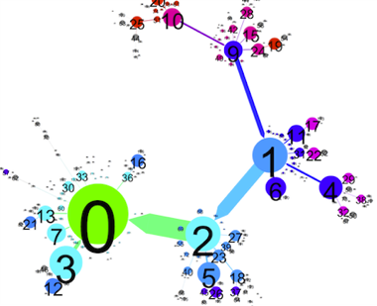
Autonomously Generating Hints by Inferring Problem Solving Policies

Slide 100

Dataset

Slide 101

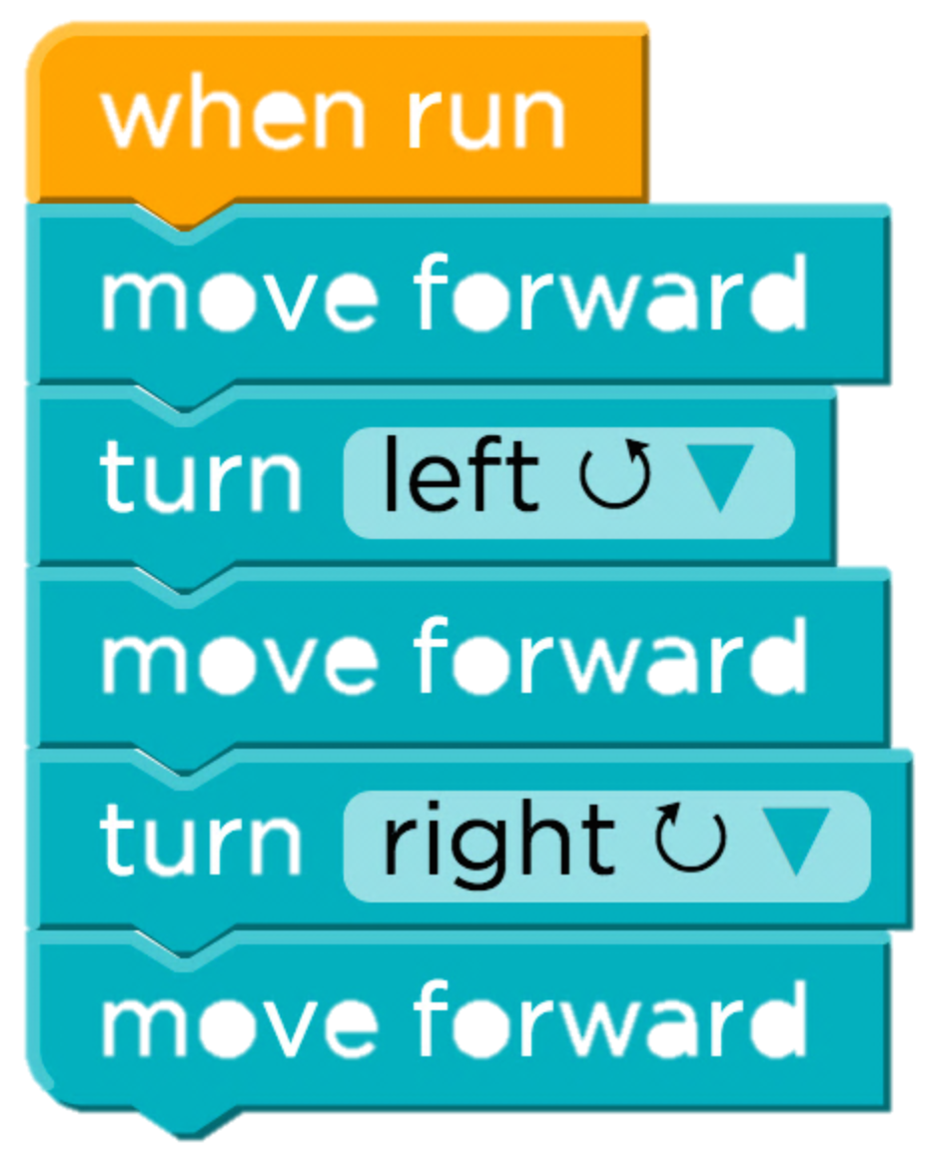
Simple
Easy Problem
Problem A
Ten thousand unique solutions
[copyright Angry Birds]

Slide 102
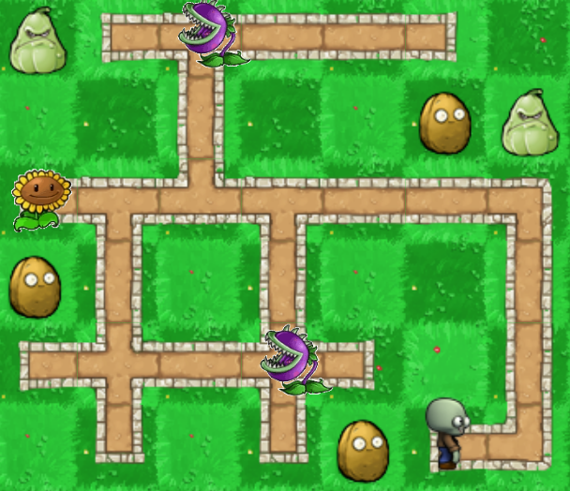
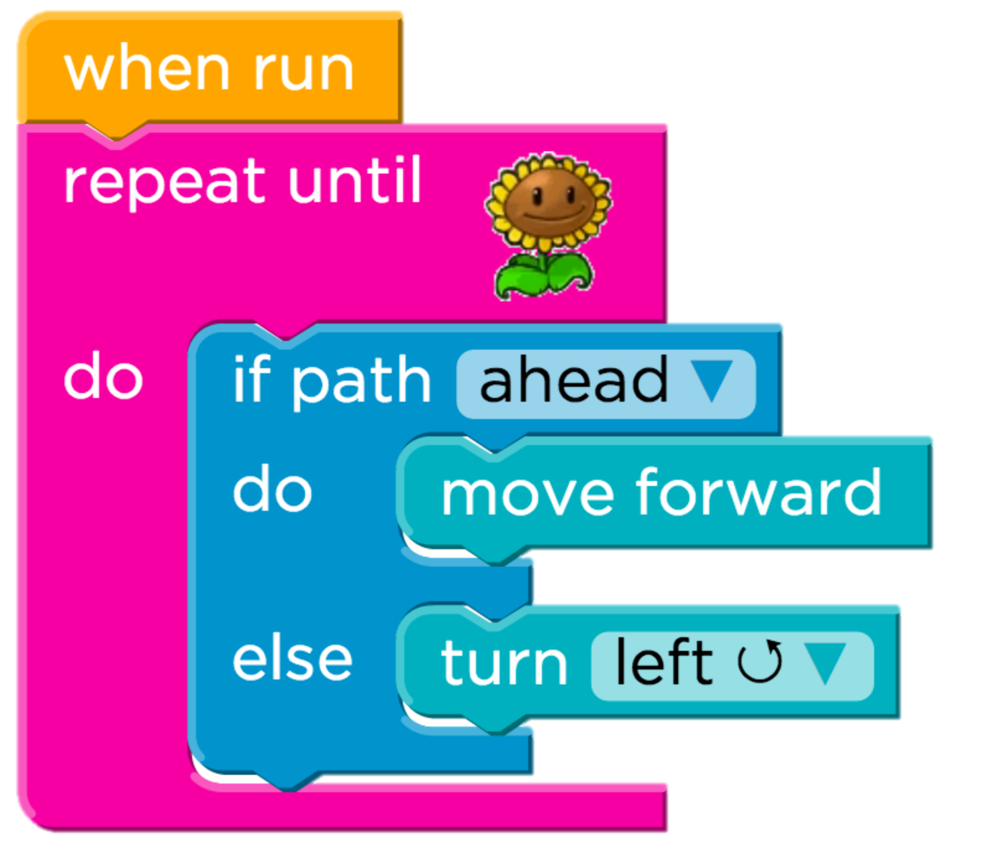
Hard Problem
Problem B
Almost a hundred thousand unique solutions

Slide 103
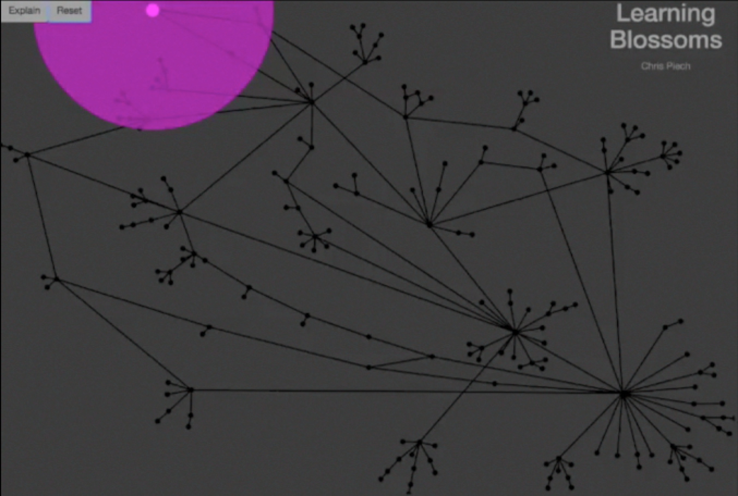

Slide 104
Each edge is what a teacher suggested
Pink dots are students.
Each node is a unique partial solution
Solution

Slide 105
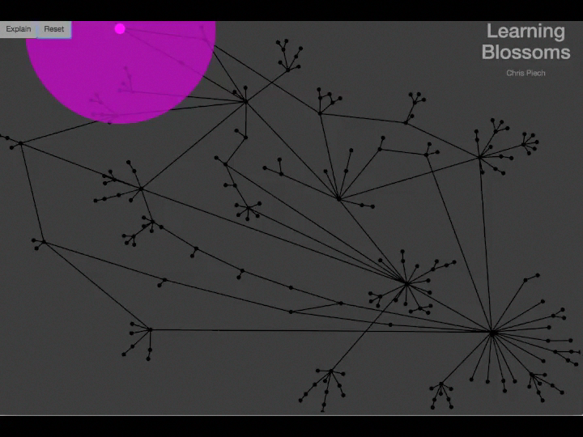

Slide 106
Demographics
Obama
N: 253,500
Age Range: [5, 105]
Mode Age: 13

Slide 107
Machine Learning Problem
solution
Unique submissions

Slide 108
Problem Solving Policy
Machine Learning Problem
solution
Teacher “Policy”

Slide 109
Example Student
solution
Student 1

Slide 110
Example Student
solution
Student 2

Slide 111
Example Student
solution
Student 1,203,403

Slide 112
Machine Learning Problem
solution
Teacher “Policy”

Slide 113
Most Ideas Don’t Work
Easiest Problem
Hardest Problem
86.3%
8.2%
47.6%
4.3%
State of the Art
Desirable Path Algorithms

Slide 114

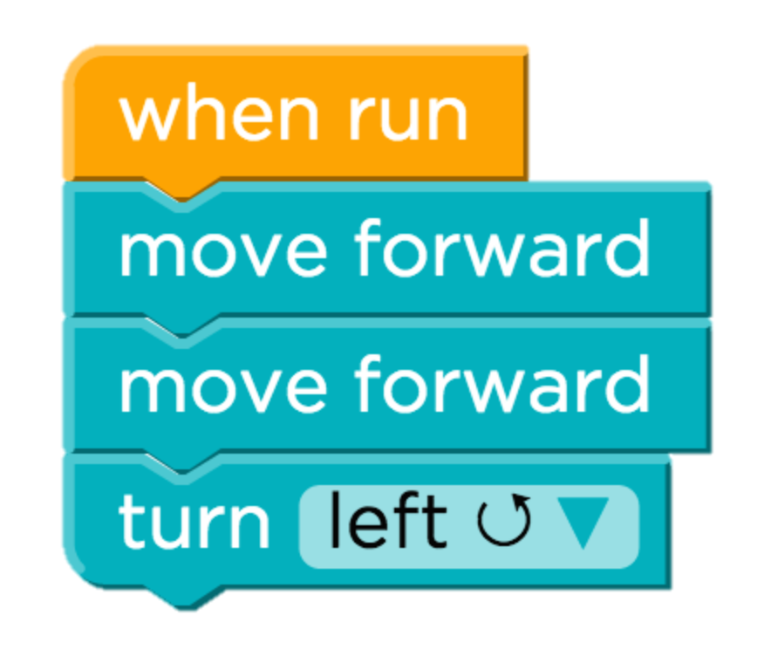
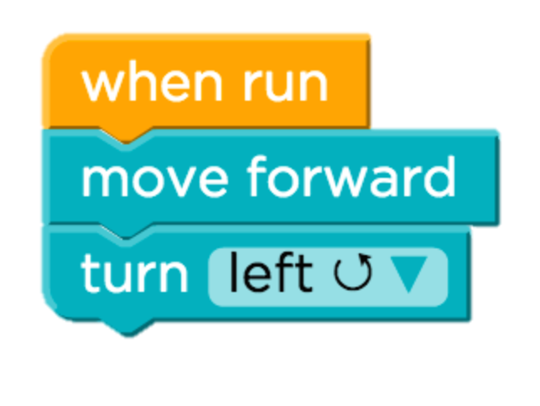
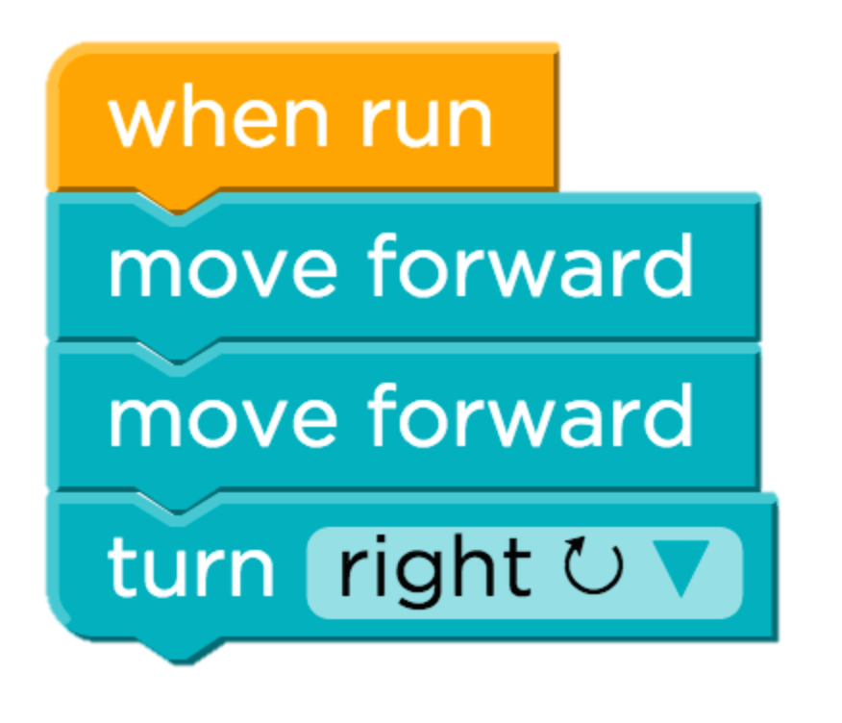
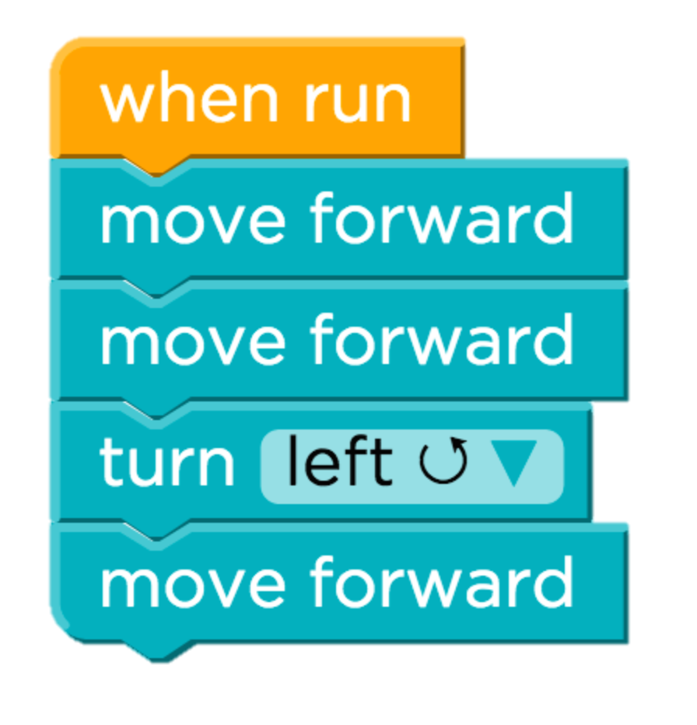
The Crowd is Un-wise
18%
45%
12%
Notes:
Fix this so that its more obvious what is happening.

Slide 115
The Crowd is Un-wise
In 52% of partial solutions the mode next disagrees with experts
Can’t trust wisdom of students that went wrong.

Slide 116
What can we do?

Slide 117
How Can We Hallucinate Average Students?
Imagine Average Students
The number of times a partial solution is submitted is a signal of how desirable that partial solution was to the average student.

Slide 118
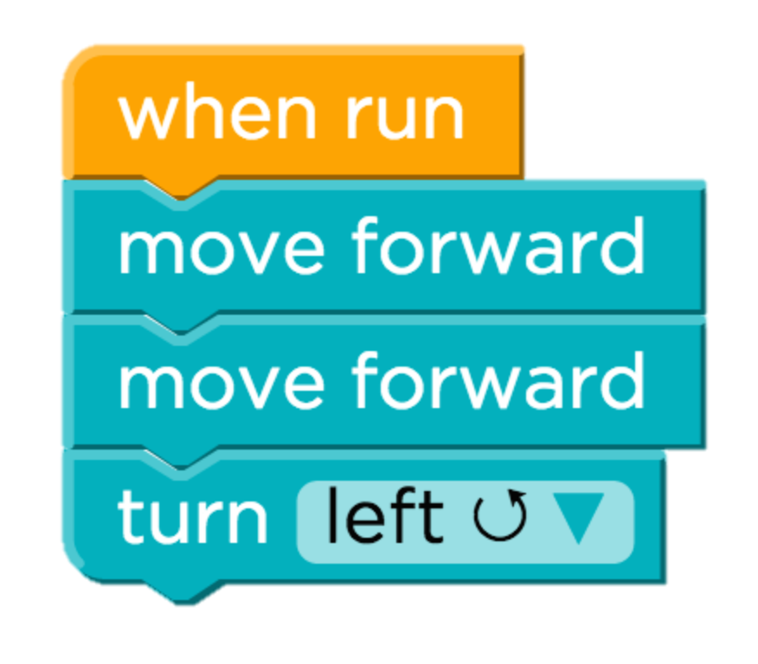
Desirable Path Algorithm

Slide 119
Desirable Path Algorithm
Average student drawn from the class

Slide 120
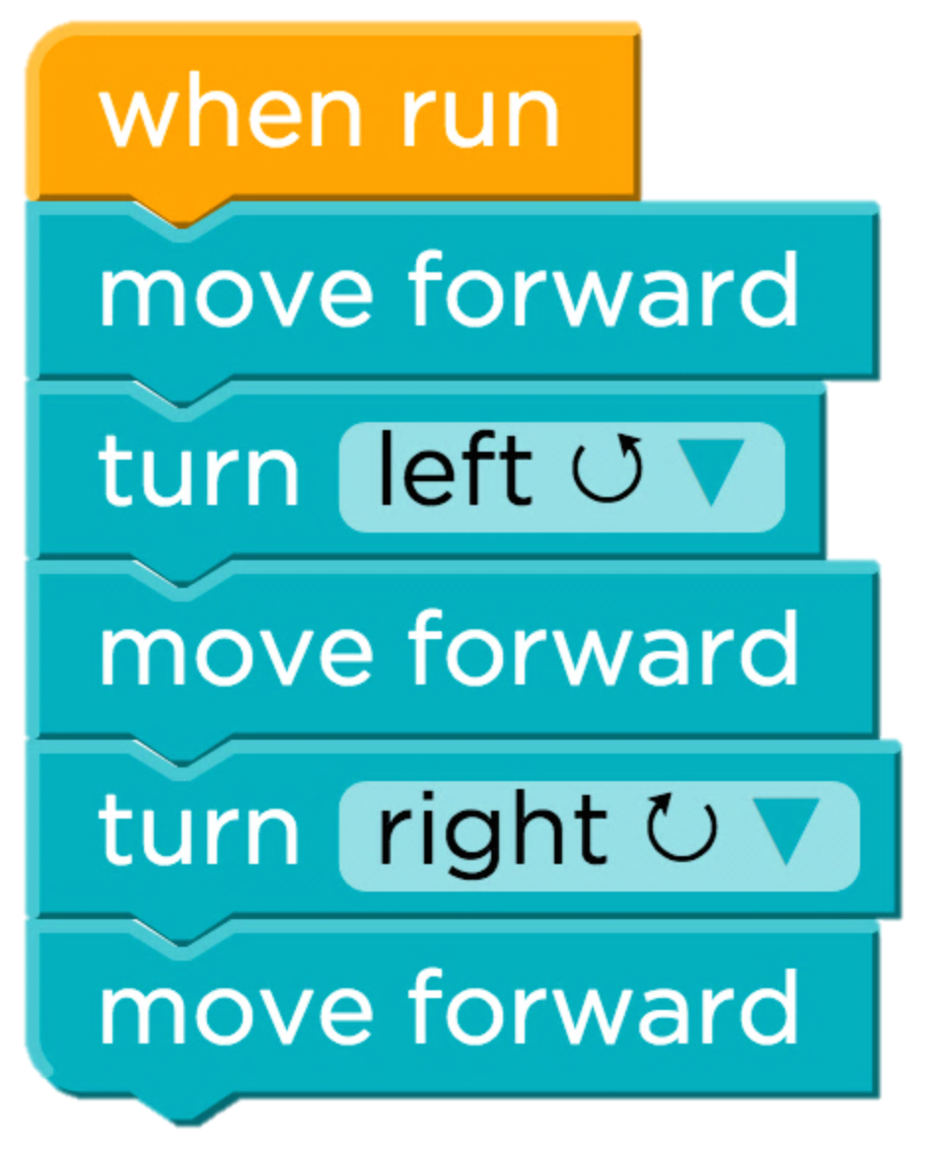
Desirable Path Algorithm

Slide 121
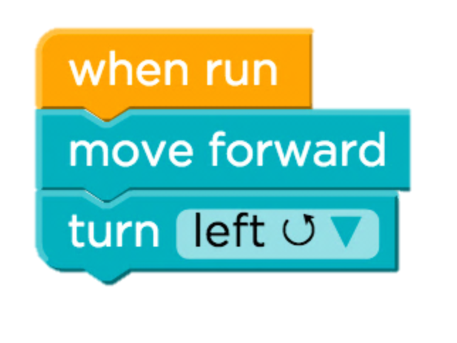
Desirable Path Algorithm
…

Slide 122
Desirable Path Algorithm
…

Slide 123
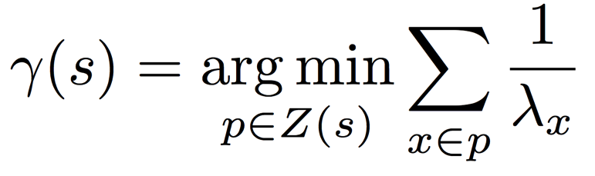
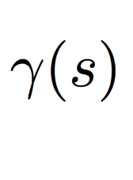
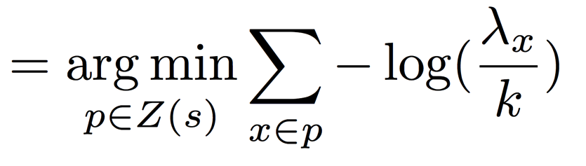
Desirable Path Algorithms
Poisson Common Path
First step in the most frequent path to the solution from s, taken by average students. Assume poison process.
Predicted next partial solution
Independent Probable Path
First step in the most likely path to the solution from s, taken by an average student. Assume markov process.
Total number of submissions
Notes:
Two algorithms
Both theoretically approximate what an average student would do from a state.
Both are closed form.
Look kinda similar ☺.

Slide 124
Desirable Path Algorithms
Poisson Common Path
Path Cost
Submission count of partial solution
Predicted next partial solution
Partial solutions in the path
Paths to solution
Count of partial solution
Independent Probable Path
Total number of submissions
Notes:
Two algorithms
Both theoretically approximate what an average student would do from a state.
Both are closed form.
Look kinda similar ☺.

Slide 125
Desirable Path Algorithms
Poisson Common Path
Path Cost
Submission count of partial solution
Predicted next partial solution
Partial solutions in the path
Paths to solution
Notes:
Two algorithms
Both theoretically approximate what an average student would do from a state.
Both are closed form.
Look kinda similar ☺.

Slide 126
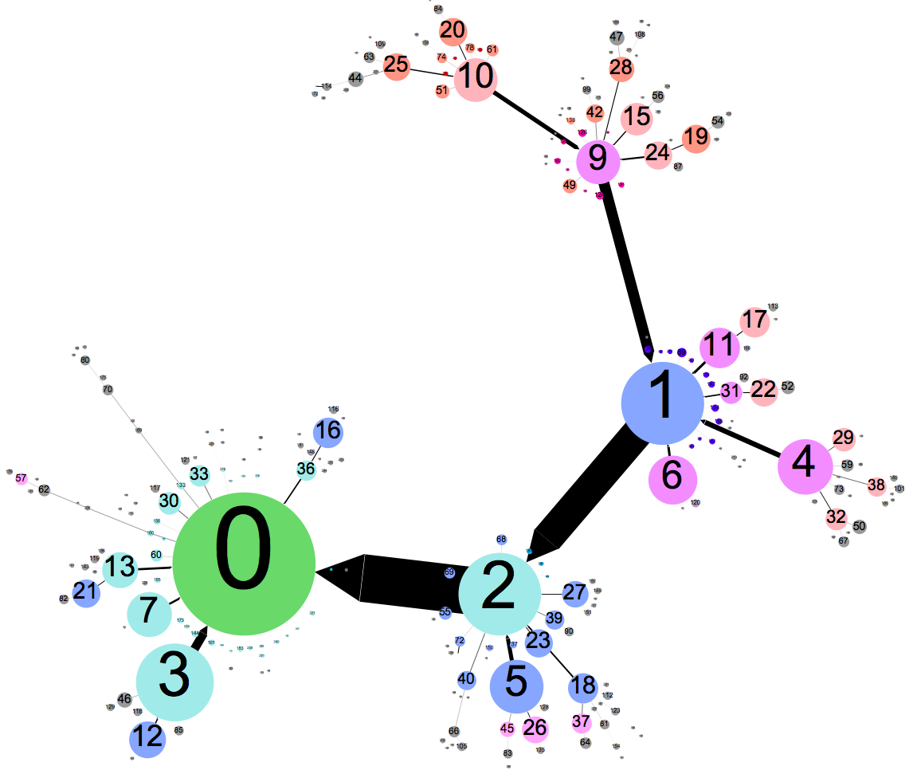
Learned Problem Solving Policy
“Backbone”
Solution

Slide 127
Most Ideas Don’t Work
Easiest Problem
Hardest Problem
86.3%
8.2%
47.6%
4.3%
State of the Art
Desirable Path Algorithms

Slide 128
Desirable Path Algorithms
Easiest Problem
Hardest Problem
95.9%
86.3%
84.6%
8.2%
47.6%
4.3%
State of the Art
Desirable Path Algorithms

Slide 129
Algorithm Scales Well
Problem A
Problem B
2⁴
2⁸
2¹²
2¹⁶
2⁴
2⁸
2¹²
2¹⁶
Need about 1,000 students for high accuracy
2⁰
2²
2⁴
2⁶
2⁸
2¹⁰
2¹²
2¹⁴
2¹⁶

Slide 130

Better Understand Learners

Slide 131

Can we use a similar framework to understand students?
Yes, we can.

Slide 132
Predicts Future Success
Problem A
Problem B
Effect is large and logrithmic.

Slide 133
Four Prototypical Trajectories
Worked great for this context

Slide 134
What about longer programs?

Slide 136

Four Prototypical Trajectories

Slide 137
Thesis Route
Thesis
Solution
Space
Assignment
Paths
Curricula
Challenge

Slide 138
Thesis Route
Thesis
Solution
Space
Assignment
Paths
Curricula
Challenge

Slide 139
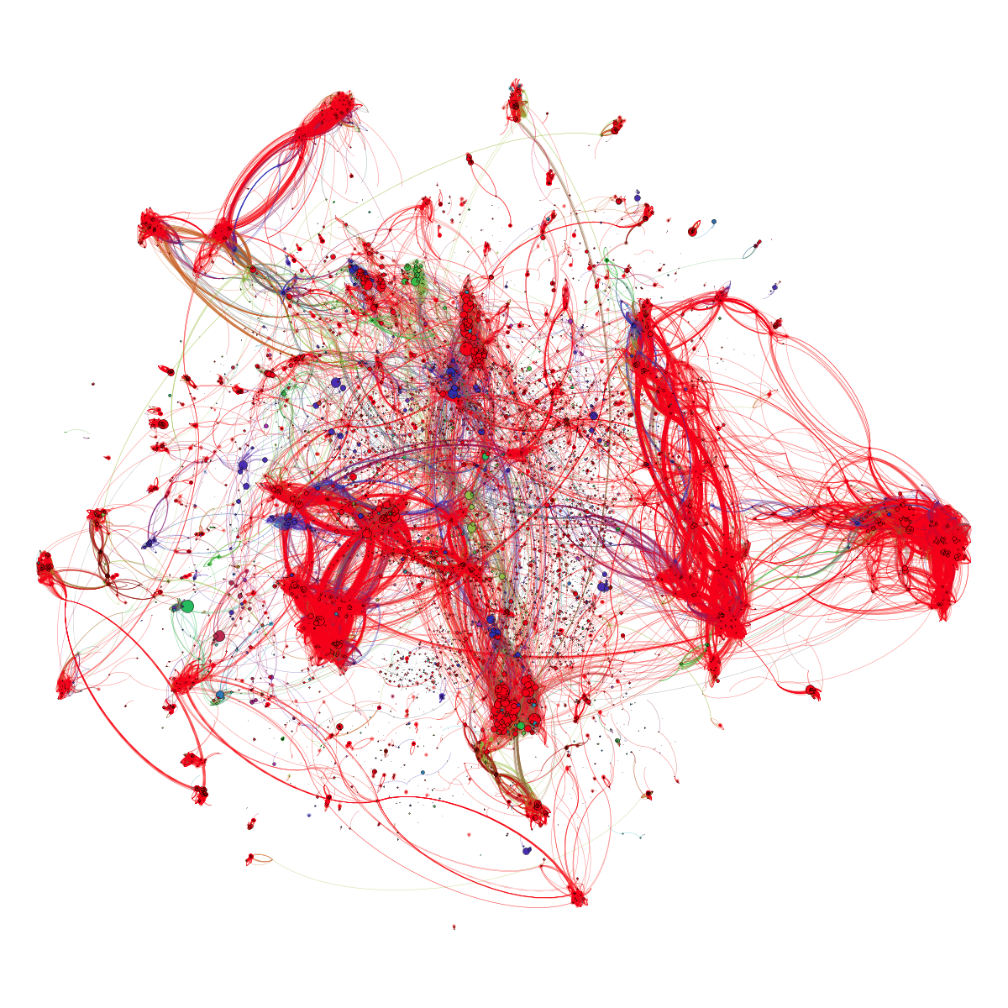

Slide 140
Edit Distance
40,000 implementations of linear regression submitted to Coursera’s ML course

Slide 141
Four Prototypical Trajectories
There must be patterns!

Slide 142
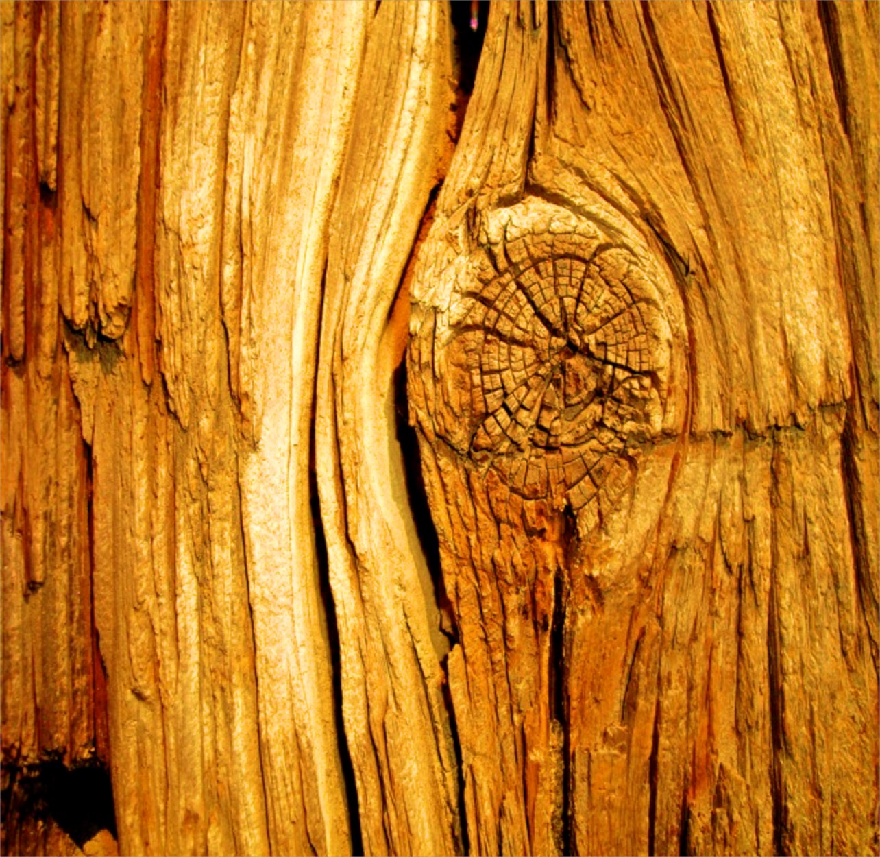

Phrases and Context

Slide 143



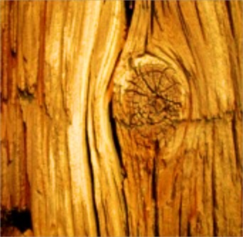
Phrases and Context Search

Slide 144
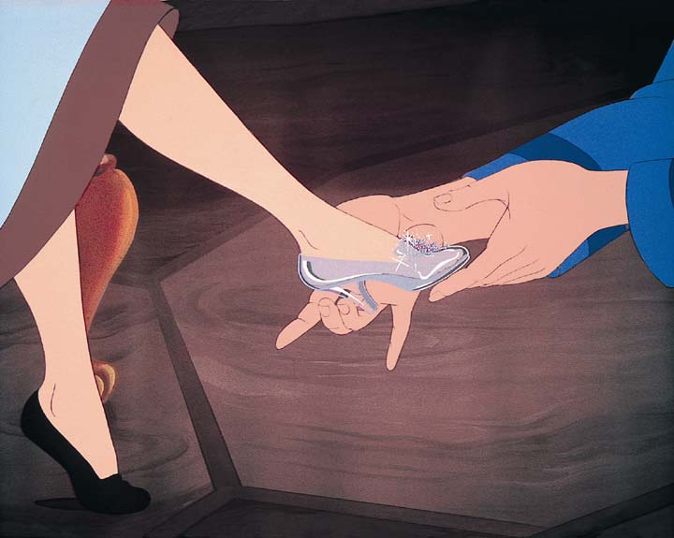
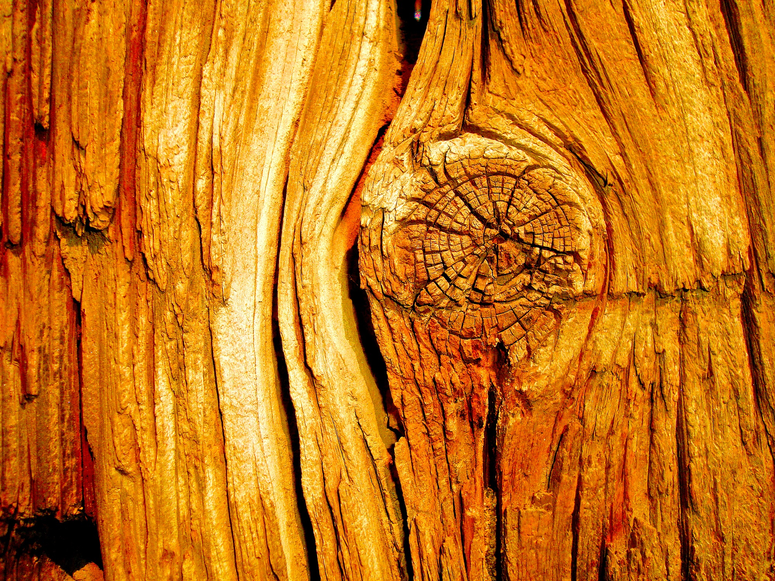


Find the Feet that Fit the Shoe
alpha*1/m

Slide 145
{m}
m
rows (X)
rows (y)
size (X, 1)
length (y)
size (y, 1)
length (x (:, 1))
length (X)
size (X) (1)
{alphaOverM}
alpha / {m}
1 * alpha / {m}
alpha .* 1 / {m}
1 / {m} * alpha
alpha .* (1 / {m})
alpha ./ {m}
alpha * inv ({m})
alpha * pinv ({m})
1 .* alpha ./ {m}
alpha * (1 ./ {m})
alpha * 1 ./ {m}
alpha * (1 / {m})
.01 / {m}
alpha .* (1 ./ {m})
alpha * {m} ^ -1
{hypothesis}
{residual}
(X * theta)
(X * theta - y)
(theta' * X')'
(theta' * X' - y')'
[X] * theta
({hypothesis} - y)
(X * theta (:))
({hypothesis}' - y’)'
theta(1) + theta (2) * X (:, 2)
[{hypothesis} - y]
…
…
sum(X.*repmat(theta',{m},1), 2)
sum({hypothesis} - y, 2)

Slide 146
Force Multiply Grading
Number of Equivalence Classes:

Slide 147
Four Prototypical Trajectories
Pretty good.

Slide 148
Four Prototypical Trajectories
Useful for Machine Learning?

Slide 149
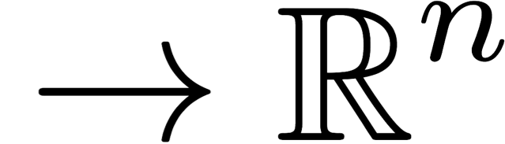
Program Embedding Space
Program
Raw programs are not amenable to machine learning algorithms

Slide 150

Program Embedding Space
private void placeRow(){
while(isClear()){
putBeeper();
move();
}
putBeeper();
}
…

Slide 151
Desiderata
Four Prototypical Trajectories
Function
Style
Notes:
Desiderata: be predictive of function and style. Lets first focus on function.

Slide 152
Desiderata
Four Prototypical Trajectories
Function
Notes:
Desiderata: be predictive of function and style. Lets first focus on function.

Slide 153

Karel
Salut
Full control flow. No variables
Notes:
He looks like an old machintosh machine.
Hes got legs… one sticks out the back. That’s just the way it is.

Slide 154

Midpoint
public class Midpoint {
public void run() {
setUp();
while(noBeepersPresent()) {
moveToBeeper();
turnAround();
move();
putBeeper();
move();
}
cleanUp();
}
private void setUp() {
putBeeper();
moveToWall();
putBeeper();
turnAround();
move();
}
[more methods defined]
}
Insert a picture of midpoint
1
2
3
4
5

Slide 155

Challenge
63,820 program is not enough to “learn how to program”

Slide 156

Collect Tripples
Precondition
putBeeper();
move();
Code
About 5 million triples per assignment
Notes:
We capture functionality using precondition/code/postcondition triples. That is for every precondition what will the postcondition be when we run this particular piece of code. As an aside, these triples are called Hoare triples in literature after Sir Tony hoare.

Slide 157

Collect Tripples
Precondition
putBeeper();
move();
Code
Postcondition
About 5 million triples per assignment
Notes:
We capture functionality using precondition/code/postcondition triples. That is for every precondition what will the postcondition be when we run this particular piece of code. As an aside, these triples are called Hoare triples in literature after Sir Tony hoare.

Slide 158


Neural Network for Programs
method step() {
putBeeper();
move();
}
Notes:
These neural networks let us capture complicated non linear features of preconditions and postcondition. This mapping is still a linear mapping. But. It is a mapping from a non-linear feature space to a non-linear features. Thus its capable of capturing complicated, non-linear behavior.

Slide 159
Neural Network for Programs
method step() {
putBeeper();
move();
}
Program Matrix
Raw Precondition
Notes:
These neural networks let us capture complicated non linear features of preconditions and postcondition. This mapping is still a linear mapping. But. It is a mapping from a non-linear feature space to a non-linear features. Thus its capable of capturing complicated, non-linear behavior.

Slide 160
Neural Network for Programs
method step() {
putBeeper();
move();
}
Program Matrix
Encoder
Raw Precondition
…
Notes:
These neural networks let us capture complicated non linear features of preconditions and postcondition. This mapping is still a linear mapping. But. It is a mapping from a non-linear feature space to a non-linear features. Thus its capable of capturing complicated, non-linear behavior.

Slide 161
Neural Network for Programs
method step() {
putBeeper();
move();
}
Multiply Program Matrix
Encoder
Raw Precondition
…
…
Notes:
These neural networks let us capture complicated non linear features of preconditions and postcondition. This mapping is still a linear mapping. But. It is a mapping from a non-linear feature space to a non-linear features. Thus its capable of capturing complicated, non-linear behavior.

Slide 162
Neural Network for Programs
method step() {
putBeeper();
move();
}
Multiply Program Matrix
Encoder
Decoder
Raw Precondition
Raw Postcondition
…
…
Notes:
These neural networks let us capture complicated non linear features of preconditions and postcondition. This mapping is still a linear mapping. But. It is a mapping from a non-linear feature space to a non-linear features. Thus its capable of capturing complicated, non-linear behavior.

Slide 163
Neural Network for Programs
method step() {
putBeeper();
move();
}
Multiply Program Matrix
Encoder
Decoder
Raw Precondition
Raw Postcondition
…
…
Prediction Loss
Notes:
These neural networks let us capture complicated non linear features of preconditions and postcondition. This mapping is still a linear mapping. But. It is a mapping from a non-linear feature space to a non-linear features. Thus its capable of capturing complicated, non-linear behavior.

Slide 164
Neural Network for Programs
method step() {
putBeeper();
move();
}
Multiply Program Matrix
Encoder
Decoder
Raw Precondition
Raw Postcondition
…
…
Decoder
Autoencoding Loss
Prediction Loss
Notes:
These neural networks let us capture complicated non linear features of preconditions and postcondition. This mapping is still a linear mapping. But. It is a mapping from a non-linear feature space to a non-linear features. Thus its capable of capturing complicated, non-linear behavior.

Slide 165
Four Prototypical Trajectories
Does it work?

Slide 166
Predicting Output
Common
Edit Distance
Program Embedding
Code phrase embeddings capture functionality of student code!
Code.org
Newspaper
Midpoint

Slide 167

Intuition
Notes:
These neural networks let us capture complicated non linear features of preconditions and postcondition. This mapping is still a linear mapping. But. It is a mapping from a non-linear feature space to a non-linear features. Thus its capable of capturing complicated, non-linear behavior.

Slide 168




A Code Phrase is a Mapping
All possible preconditions
…
Notes:
We like to summarize code as a mapping from preconditions to postconditions.

Slide 169
A Code Phrase is a Mapping
All possible preconditions
All possible postconditions
…
…
Notes:
We like to summarize code as a mapping from preconditions to postconditions.

Slide 170
A Code Phrase is a Mapping
All possible preconditions
All possible postconditions
putBeeper();
move();
…
…
Notes:
We like to summarize code as a mapping from preconditions to postconditions.

Slide 171
A Code Phrase is a Mapping
All possible preconditions
All possible postconditions
putBeeper();
move();
…
…
Notes:
We like to summarize code as a mapping from preconditions to postconditions.

Slide 172


A Mapping Can Be Represented as a Matrix
0
1
0
0
0
0
0
0
0
1
0
0
0
0
Notes:
We like to summarize code as a mapping from preconditions to postconditions.

Slide 173
A Mapping Can Be Represented as a Matrix
0
1
0
0
0
0
0
0
0
1
0
0
0
0
0/1 matrix representing: precondition postcondition mapping
=
Ridiculous
Notes:
We like to summarize code as a mapping from preconditions to postconditions.

Slide 174
A Mapping Can Be Represented as a Matrix
matrix representing: precondition postcondition mapping
=
Precondition
features
Postcondition
features
Notes:
We like to summarize code as a mapping from preconditions to postconditions.

Slide 175
Desiderata
Four Prototypical Trajectories
Function
Notes:
Desiderata: be predictive of function and style. Lets first focus on function.

Slide 176
Desiderata
Four Prototypical Trajectories
Function
Style
Notes:
Desiderata: be predictive of function and style. Lets first focus on function.

Slide 177





Predicting Feedback
It looks like you have a fencepost error!
// User defined method
private void run() {
while(isClear()){
putBeeper();
move();
}
putBeeper();
}
run
while
putBeeper
cond
body
Richard Socher et al. Semi-supervised recursive autoencoders for predicting sentiment distributions. Conference on Empirical Methods in Natural Language Processings, 2011.
putBeeper
move

Slide 178
Four Prototypical Trajectories
And?

Slide 179
Predicting Feedback
1. Compute Embeddings
2. Annotate 500 Submissions
3. Autonomously Propagate

Slide 180
Predicting Feedback
1. Compute Embeddings
2. Annotate 500 Submissions
3. Autonomously Propagate
Hardest Code.org Assignment
Hardest Karel Assignment
AST
Edit Distance
AST
Edit Distance

Slide 181
Predicting Feedback
1. Compute Embeddings
2. Annotate 500 Submissions
3. Autonomously Propagate
Hardest Code.org Assignment
Hardest Karel Assignment
Neural Network
Neural Network
AST
Edit Distance
AST
Edit Distance

Slide 182
Predicting Feedback
1. Compute Embeddings
2. Annotate 500 Submissions
3. Autonomously Propagate
Hardest Code.org Assignment
Hardest Karel Assignment
Neural Network
Bag of Trees
Neural Network
Bag of Trees
Equivalence
AST
Edit Distance
AST
Edit Distance

Slide 183
Predicting Feedback
1. Compute Embeddings
2. Annotate 500 Submissions
3. Autonomously Propagate
Hardest Code.org Assignment
Hardest Karel Assignment
Neural Network
Neural Network
AST
Edit Distance
AST
Edit Distance

Slide 184
Predicting Feedback
1. Compute Embeddings
2. Annotate 500 Submissions
3. Autonomously Propagate
Hardest Code.org Assignment
Hardest Karel Assignment
Neural Network
Neural Network
214×
45×
AST
Edit Distance
AST
Edit Distance

Slide 185




Code.org Feedback
Hardest Code.org Assignment
Hardest Karel Assignment
Colors are functionally equivalent
Colors represent correctness
100%
Principle Component 1
Principle Component 1
0%
Principle Component 2
Principle Component 2

Slide 186
Four Prototypical Trajectories
Embeddings have lots of potential

Slide 187
Thesis Route
Thesis
Solution
Space
Assignment
Paths
Curricula
Challenge

Slide 188
Thesis Route
Thesis
Solution
Space
Assignment
Paths
Curricula
Challenge

Slide 189
Today’s Goals
Introduce the zeitgeist of data driven education
Show the progress that I have made

Slide 190
Grand Challenge in Education
Clear
Societal Need
Grand Challenge
in Education
Increase
education
productivity
Autonomously support teachers. Can we
understand individual learning and provide
quality feedback for students as they work
on assignments?
MOOC
assignments
Neural
networks
New
Datasets of
Learning
New Machine
Learning
Education debt > Consumer debt

Slide 191
Progress
Understanding Curriculum Navigation
Understanding Problem
Navigation
Understanding Solution
Space
Peer
Grading
Correct/
Incorrect
Maze
Programs
Control Flow Programs
General Programs

Slide 192
Progress
Understanding Curriculum Navigation
1
Understanding Problem
Navigation
2
Understanding Solution
Space
3
3
3
Peer
Grading
Correct/
Incorrect
Maze
Programs
Control Flow Programs
General Programs

Slide 193
Main Contributions
Improvement in the state of the art for the task of Knowledge Tracing (predicting future student responses) using recurrent neural networks.
Discovered the Poisson Path pattern in how students navigate solution spaces that both: predicts how teachers would suggest a learner make forward progress and has an almost perfect logarithmic relationship with the probability of future completion.
Developed a neural network based algorithm to autonomously embed student programs into Euclidian space.

Slide 194


Data and Code are Public

Slide 195
Where next?

Slide 196


Slide 197


Slide 198


Deep Q Learner

Slide 199




How it Works
Last 4 frames (s)
Q(s, a)
Neural Net

Slide 200
How it Works
Last 4 frames (s)
Q(s, a)
Neural Net
Eg the utility of each action

Slide 201

How it Works
Last 4 frames (s)
Q(s, a)
Neural Net
Eg the utility of each action
The loss that is propagated is based on Bellman:

Slide 202

A Better Game

Slide 203
Tutor Game
Student Simulator

Slide 204

Tutor Game
Student
Student Simulator
Attempted a Question

Slide 205

Tutor Game
Student
Updated
Student
Student Simulator
Answered the question incorrectly
Attempted a Question

Slide 206
Tutor Game
Student Simulator

Slide 207

Tutor Game
Student
Student Simulator
Is given a hint

Slide 208
Tutor Game
Student
Student Simulator
Updated
Student
Is given a hint

Slide 209
Tutor Game
Hierarchy of concepts
Student Simulator
Students has “ability” for each concept
Each question corresponds to one concept
Each hint corresponds to one concept
Etc…

Slide 210
Deep Tutor
y
h
x

Slide 211
Deep Tutor
y
Q-value
Neural Net
h
x

Slide 212
Deep Tutor
y
Q-value
Neural Net
Back propagate
loss
h
x

Slide 213
Deep Tutor

Slide 214

Unified Model
Neural Net
Q-value
h
encoding(question)
x
encoding(response)

Slide 215

Unified Model
Neural Net
Q-value
h
encoding(question)
x
encoding(response)

Slide 216
The End.

